Slide 1
Extractive and abstractive text summarization of us supreme court opinions
Karthik Narasimhan
Stakeholder: Daniel Friedman, Visiting Assistant Professor of Law, Villanova University

Slide 2
Extractive vs abstractive text summarization
Extractive: Identifies the most important sections of a text based on scoring mechanism and extracts them to form a new summary. No training on human-written summaries required.
Abstractive: Learns the meaning of the text and generates a new summary that conveys the most important information, with wording that may not be in original text. Training on human-written summaries required.
Abstractive summarization is a more difficult problem than extractive but is closer to human-written summaries than extractive.

Slide 3
Us Supreme Court opinions and syllabi
Abstractive text summarization is possible with US Supreme Court opinions because every US Supreme Court opinion is prefaced by a syllabus written by the Reporter of Decisions that summarizes the facts of the case and the Court’s holding.

Slide 4
motivation
According to law professor Richard Fallon, there are three types of legitimacy relevant to the US Supreme Court: legal legitimacy, moral legitimacy, and sociological legitimacy.
Sociological legitimacy is important because our Constitutional system depends on elected officials following the Court’s decisions even if they do not agree with them.
Public approval has declined recently partly because the Court has d​ecided to prioritize legal legitimacy over sociological legitimacy, and the reasoning of the opinions have become too abstruse for most of the public to understand. When people cannot understand the Court’s reasoning, they look directly to the Court’s final decision to find out who “won” and who “lost”, regardless of how the Court came to that conclusion. If they feel that their side “lost”, their approval of the Court declines.
My motivation behind this research project, and any subsequent research on this subject, is to develop a language model that can summarize US Supreme Court opinions in a manner than the public can understand, without the bias of legal commentators in the media to help maintain the sociological legitimacy of the Court.

Slide 5
dataset
816 US Supreme Court opinion-syllabus pairs
100 of these opinions & syllabi were copied from recent opinions on US Supreme Court website
716 opinions & syllabi were retrieved from CourtListener database maintained by Free Law Project

Slide 6
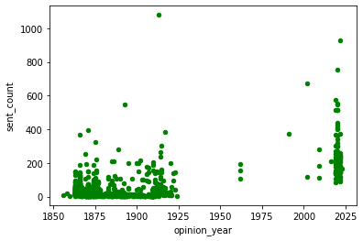
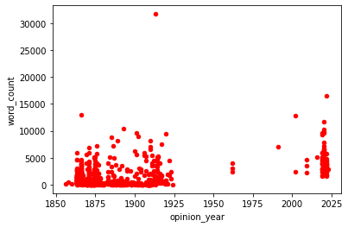
Exploratory data analysis

Slide 7
Domain-specific vocabulary
The corpus of specialized domains such as law contain vocabulary terms that are not already contained within the tokenizers of pre-trained language models.
This is rectified by 45K legal terms that have been extracted from the electronic version of Black’s Law Dictionary.
I also used the program Eyecite, developed by the Free Law Project, to identify and copy all the case citations within every US Supreme Court opinion in the corpus.

Slide 8
Transformer language Models (LM) and tools
Bidirectional Encoder Representation from Transformers (BERT) – masked LM that randomly masks some of the tokens from the inputs to predict original vocab id of masked word based only on context
LEGAL-BERT: BERT model pre-trained on thousands of US court cases and contracts, and thousands of court cases from the EU
BERT Extractive Summarizer – tool that uses a BERT model (original or pre-trained) to perform extractive summarization
BART – LM with bidirectional encoder over corrupted text and left-to-right autoregressive encoder. Suitable for abstractive summarization
BillSum – corpus of thousands of US Congressional bills and human-written summaries, used for training LMs for abstractive summarization

Slide 9
Extractive summarization process
Extractive Summarization of US Supreme Court opinion-syllabus pairs is performed first because BART model can only accept inputs of up to 1024 tokens in length and Court opinions are substantially longer than that
Using BERT Extractive Summarizer with LEGAL-BERT, 25 sentences of recent opinions and 10 sentences of recent syllabi are extracted into new extractive summaries. 50% of remaining opinions and syllabi are extracted into extractive summaries.

Slide 10
abstractive summarization process and metrics
BART model pre-trained on BillSum corpus is fine-tuned on training set (80% of corpus) of extractive summaries of US Supreme Court opinion-syllabus pairs
Hyperparameters: 300 steps, Batch Size of 8, Gradient Accumulation Steps of 8, Learning Rate of 2e-5, Adam optimizer with beta1 = .9, beta2 = .999, epsilon = 10e-8
ROUGE scores of predicted syllabi after evaluation on test set (20% of corpus):
ROUGE1: .1301
ROUGE2: .0405
ROUGEL: .1074

Slide 11
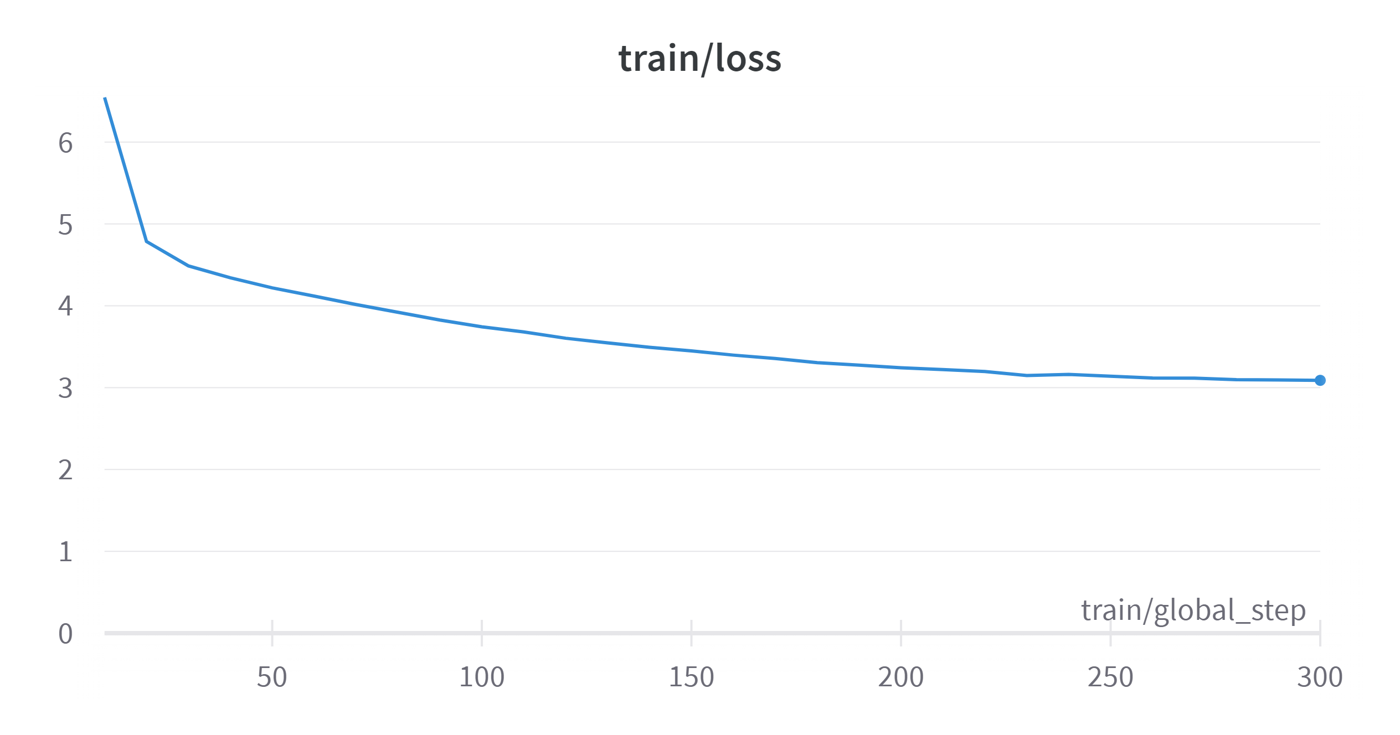
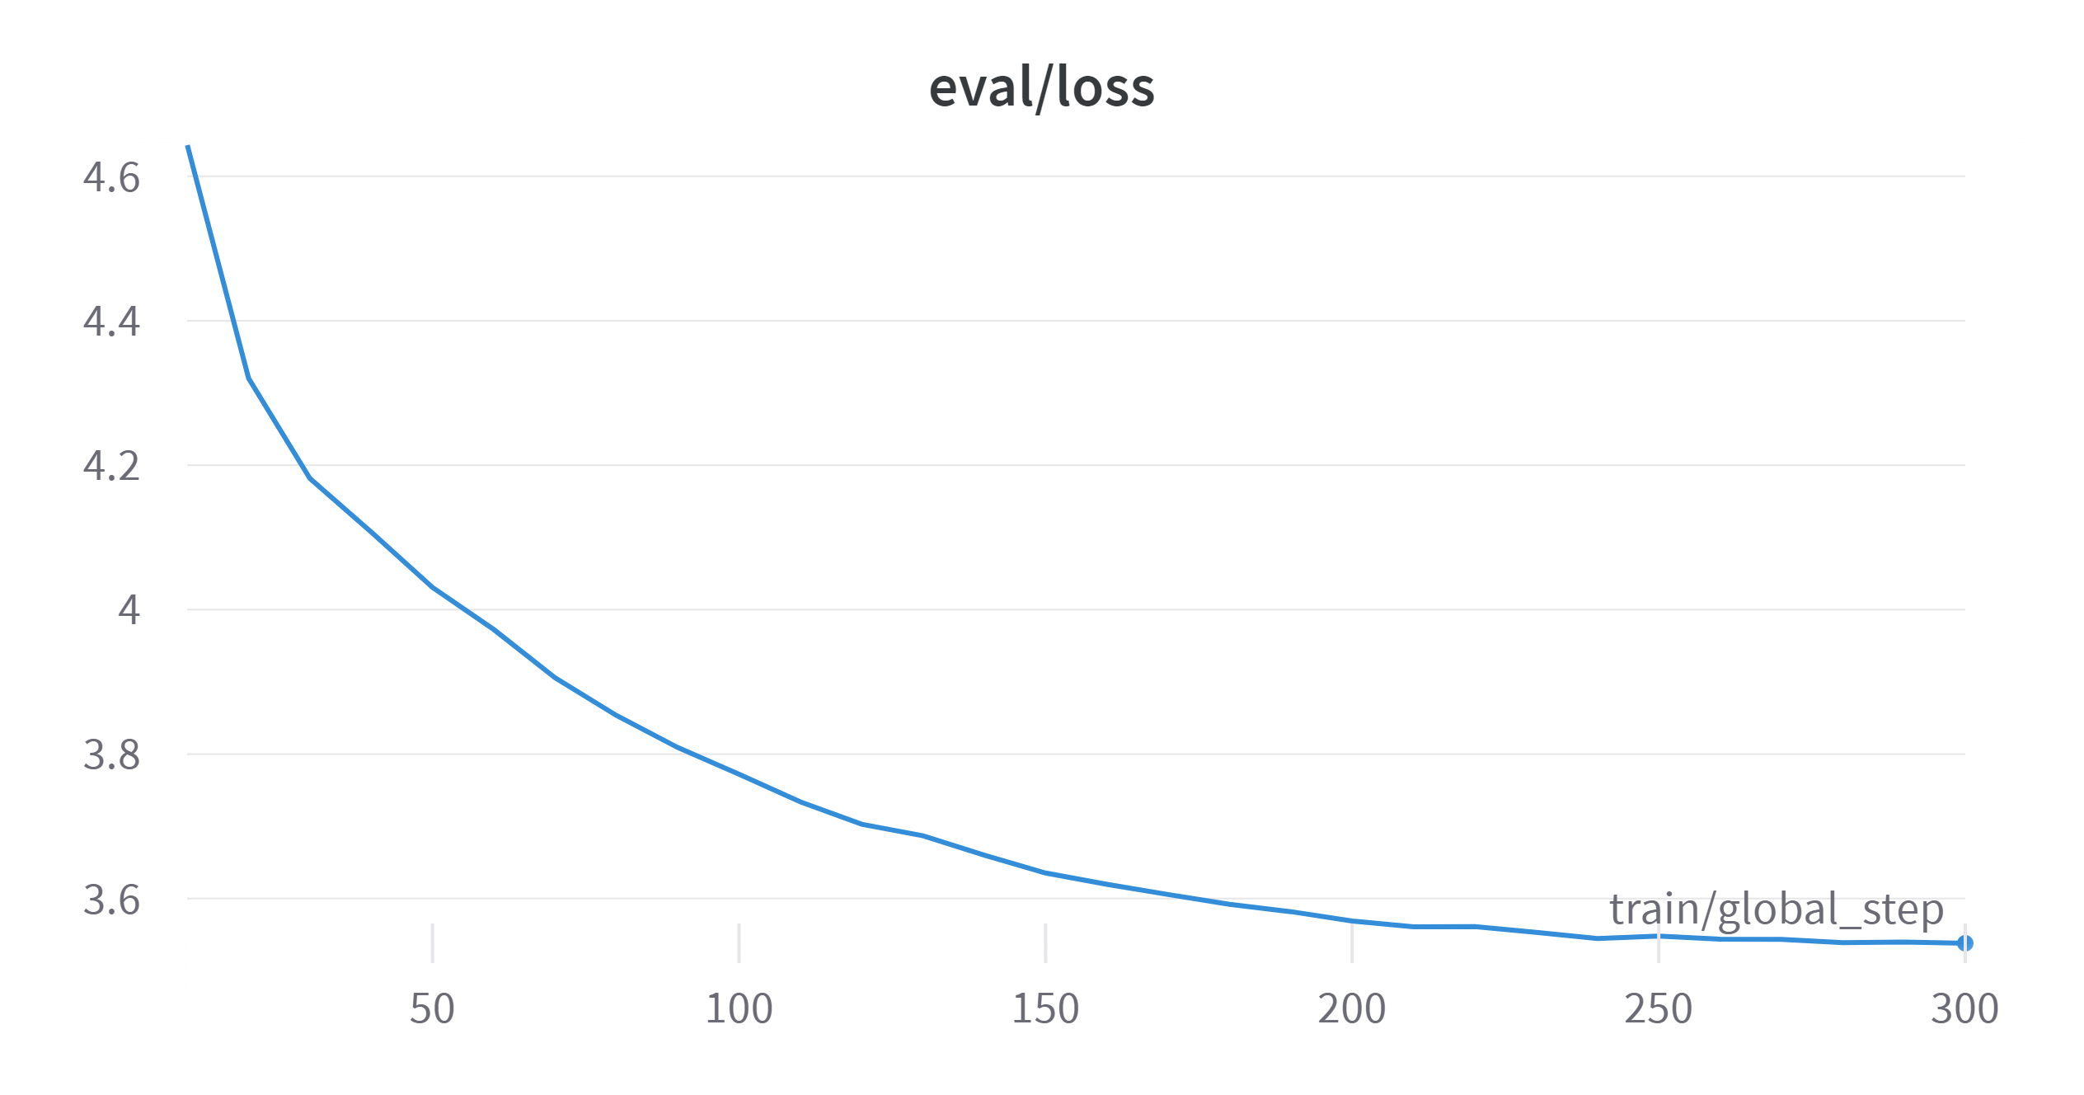
Step vs loss, Training and evaluation

Slide 12
Example of predicted syllabus and comments
Puerto Rico’s popularly ratified Constitution does not involve the President or the Senate in the selection process for local officials. The Constitution provides the President and the Senate for the selection of members of the Board of Governors of the Territory of Puerto Rico. Congress created the Board to make all needful Rules and Regulations respecting the Territory . In August 2016, President Obama selected six of the seven Board members from lists prepared by properional leaders. Puerto Rico found that it could not service that property because the Board is composed of only seven members, including the President . The Court held that the Board was not an “officer of the United States” because its duties are primarily local , and that Congress gave the Board the power to make those rules and regulations . See Metropolitan Washington Airports Authority v. Citizens for Abatement of Aircraft Noise, Inc., United States , 270–271. And in Lucia , the Court asked the same question about proper e contra propers carrying out proper duties. The "focus" of these courts was "primarily upon... the critical legal test relevant here," and they do not apply any test they might .
This case concerns the federal (not the Puerto Rican) Constitution. It’s trying to figure out whether the President can appoint people to make important decisions about PR without getting the Senate to confirm them
Provides them with what? This statement is unclear
This isn’t quite right. Congress created the Board on the basis of its general Article IV authority to make “all needful Rules and Regulations,” not so that the Board could make those regulations itself
I’m not sure what this word is
I believe this is a reference to the debt that PR was unable to service (the fact that led to the Board’s decision to declare bankruptcy) but that’s hard to understand from this statement
This makes it seem that PR’s debt problems were a result of the composition of the Board, which doesn’t make sense
This makes it sound as if the US President sits on this Board, which he doesn’t
This is correct and is the central holding of the case
Same comment as above
This makes it appear as if Metropolitan Washington Airports was about either local authority or officers of the US, which it wasn’t. The Court cites it here simply to make the point that the Appointments Clause applies to lots of situations because what it’s trying to do is to make sure that the President can’t do stuff unilaterally, which is an important basic principle of American government
This makes it seem that Lucia was an important precedent for this opinion, but the Court actually said that it wasn’t particularly relevant, because it deals with federal/national stuff, not the local authority that matters here
No idea what this means
Which courts? Meaning unclear
Meaning unclear

Slide 13
Overview of evaluation by stakeholder
Style: The generative text contains some minor spelling and grammatical errors, which sometimes make it difficult to understand the exact meanings of phrases, clauses, or whole sentences. The most significant such errors obscure who is saying what, so that a reader might not know whether a particular view belongs to one of the litigants or to the court itself.
Citation: The text generator has clearly identified that citation to other cases is an important component of legal writing, but it doesn’t seem to know how to link particular ideas to the cases it references, so that a case citation will follow a statement that has no actual connection to that opinion’s content.
Invention: Quotations are rarely accurate and sometimes include phrases that don’t appear anywhere in the opinion. Case names are also sometimes invented, sometimes by combining the names of parties from cases that do appear in the opinion.
Misstatements: The law isn’t always right, and it seems like it can be hard for the model to understand the difference between things like sources and purposes of law, e.g., whether a statute is authorized by a particular set of rules or is intended to put those rules into practice. It did not always seem capable of clearly stating which actors were required to do what and why. To be fair, most people reading cases also find this difficult.
Focus: Probably the trickiest problem is figuring out what the most important part of an opinion is. This is the thing that law students struggle the most with, too! While the model frequently raised issues that appear in the opinions it was analyzing, it rarely seemed to zero in on the key issues. This is actually quite similar to the way first-year law students discuss cases: they can tell you lots of facts about them and the ideas that they reference, but they have great difficulty reducing them to the handful of most significant points.

Slide 14
Final thoughts
While BART language model was not able to accurately summarize US Supreme Court opinions after fine-tuning, a small amount of legal correctness shows that it is possible and points the way towards further research at the intersection of AI and law.

